Slide 1
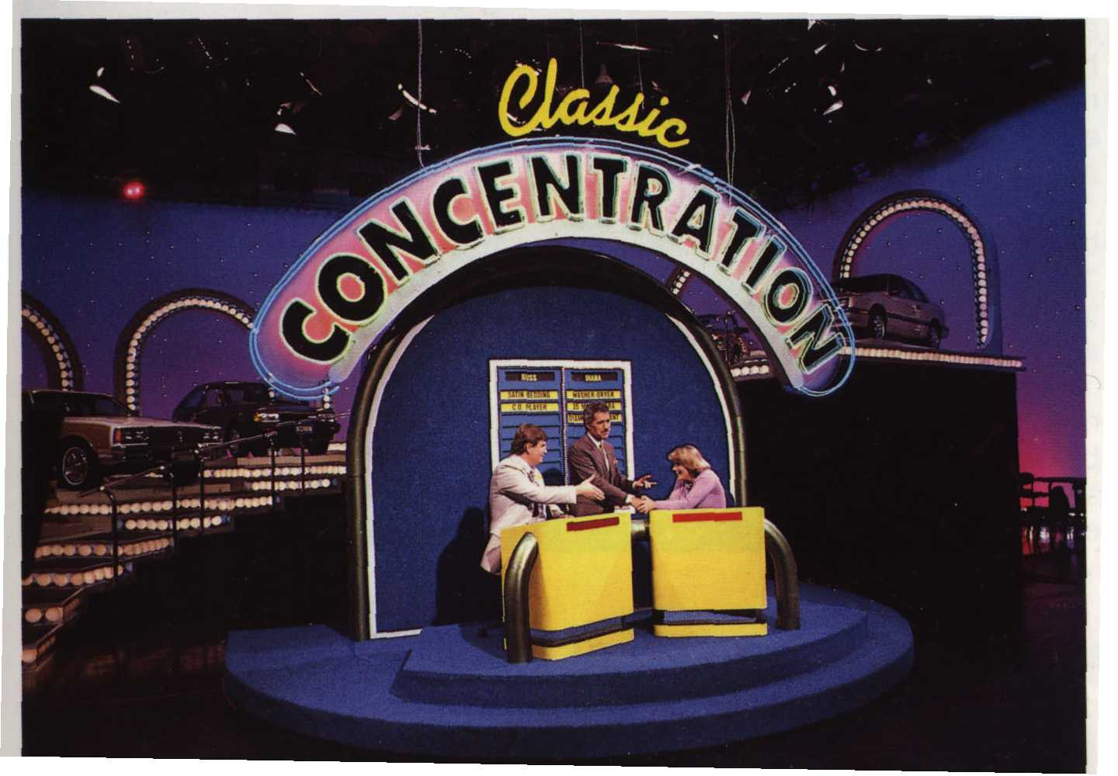

Slide 2
Concentration
Piece the clues together
Guess the word(s)
Write your response
Answers will appear in the following slide

Slide 3
business

Slide 4
Word
Small Business

Slide 5
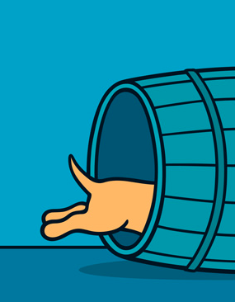
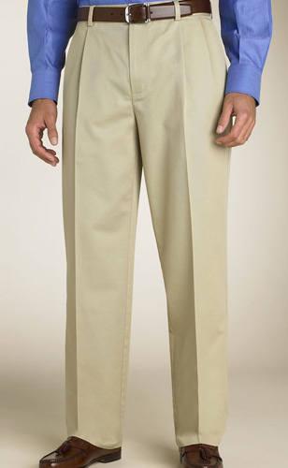

Slide 6
Word
Increase

Slide 7
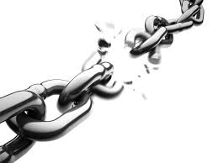



Slide 8
Word
Breakeven Point

