Slide 1
Representing Inequalities Graphically
Projector Resources

Slide 2
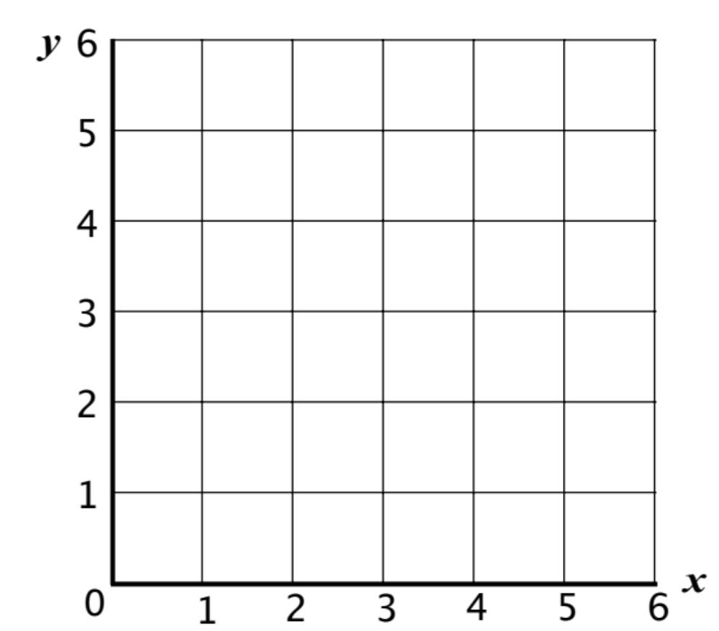
Hunting the Target

Slide 3
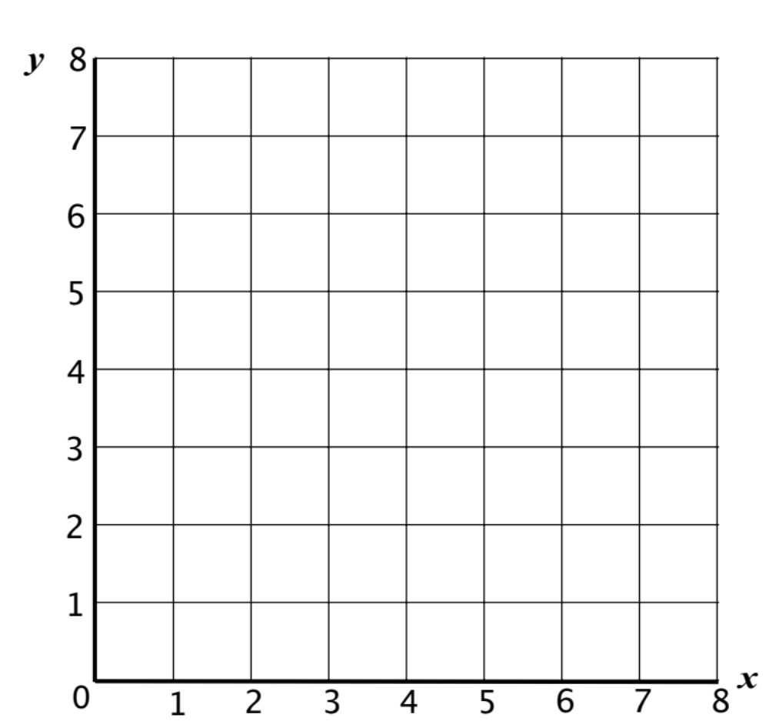
Give Us a Clue

Slide 4
Preparing to play the game
Take turns to figure out the inequalities for each region of the twelve small graphs.
Once you have done this, explain to your partner how you came to your decision.
Your partner should either explain that reasoning again in his or her own words, or challenge the reasons you gave.
You need to agree on and both be able to explain the inequalities for each region of each graph.
Make sure you write all the inequalities on your own copy of Give Us a Clue!
There is no need to shade the graphs.

Slide 5
Playing the Game
  One of you will be the target picker and the other the target hunter.
  The target picker decides on the position of the target and gives the clues.
  When giving clues, the target picker can use any inequality sign (≤, <, ≥, >), but not the ‘=‘ sign. Try to give helpful clues!
  As you give the clues, write them as a list on your mini-whiteboard.
  The target hunter uses the clues to find the target.
  The aim of the game for both partners, is to find the target in the least number of tries.
  Both partners must use a blank grid to keep track of the clues that are given.
  Each time a clue is given, shade out the region where the target cannot be located.

