Slide 1
Linear Investigation
Distinguishing between expressions, equations, and functions.
Emphasizing MP 7
2016 Megan Jeffers, Melissa Stanley, & Sarah Winzeler
Slide 1
Notes:
The PowerPoint is not meant to be given to students; it is meant to be used in guiding instruction. Each slide in the PowerPoint includes teacher notes to help facilitate the content, questions, and other ideas the authors want to convey to the teachers. In addition, the common student misconceptions are provided in the notes section for each slide. These notes are intended to help teachers understand the vision of the authors.

Slide 2
Lesson 1 Act One:
Watch the following video
https://www.youtube.com/watch?v=n_E3qkJiBBA&noredirect=1
Slide 2
Notes:
Google: Candle Burning Act 1 Video is uploaded by Kyle Pearce

Slide 3
Lesson 1 Act One:
After watching Act One of the Candle Burning video…
What do you wonder?
What do you notice?
What questions do you have?
Slide 3
Notes:
Possible student responses: What was the original height of the candle? How long did the candle take to burn out to a height of zero? As time goes on since the candle was lit, what is happening to the candle? What are fixed quantities? What are the changing quantities?
Teacher notes: If students don’t come up with the questions above, teacher may need to prompt through questioning strategies.
Misconceptions: n/a

Slide 4
Lesson 1: Act One
Make a conjecture about the length of time it would take for the candle to be half gone, and then completely gone.
What is your bravest wrong answer that is too low?
What is your bravest wrong answer that is too high?
Slide 4
Notes:
Possible student responses: Students might assume the time it takes to be completely gone is double the time it takes to be half gone. In the students’ conjectures they should rule out unreasonable values given the context (eg. negative time or negative candle height). Student responses can vary, for example students may say an hour or 30 minutes, etc.
Teacher notes: “Bravest” is a prompt for students to set parameters that are on the verge of being unreasonably too high or too low. Keep asking until students refine their responses. This is meant to motivate student discussion and facilitate questioning.
Misconceptions: n/a

Slide 5
Lesson 1: Act One
What is varying in the given situation?
2. Define expression.
3. What expression would represent the change in the candle’s height?
4. What expression would represent the change in the time?
Slide 5
Notes:
Possible student responses:
For question, 1 the quantities varying are height of the candle and time the candle has been burning.
For question 2, we want students to see expressions as a process of computing and a product of the computation. It is important students see expressions as multiple equivalent representations.
For question 3, (new height – initial height); (h – h₁); (h₂ – h₁); ∆h; students could give specific numbers they consider reasonable.
For question 4, (new time – initial time); (t – t₁); (t₂ – t₁); ∆t; students could give specific numbers they consider reasonable.
Teacher notes: Students who are struggling to come up with expressions: ask for possible values they could substitute in for values of height or time. Discuss as a class what students know about expressions. Possible activity to define an expression is using a Frayer Model to help strengthen vocabulary.
Misconceptions: Possibly some confusion between expression and equation. If this occurs, spend the time to build precise vocabulary.

Slide 6
Lesson 1: What information do you still need?
Two measurements were taken. The candle height after 24 minutes is 15 cm and the height after 105 minutes is 12 cm.
Determine the length of time it takes for the candle height to be 0 cm, assuming the rate of change of height with respect to time is constant.
Make sure to provide evidence to support your answer and be ready to present to your classmates.
Slide 6
Notes:
Possible student responses:
Students may use a table or graph to help identify patterns within the two given points. Students may start identifying that every time the height decreases by 3 the time increases by 81 minutes. If they continue this pattern they can find when the height is zero cm.
Teacher notes: Encourage students to use tables and graphs if they don’t have a place to begin. Encourage students to find patterns within the quantities given. For students who get the answer quickly, extend their thinking to prove it by finding the answer another way or working backward to validate they are correct. It is very important that students begin to look at these changes as expressions and identify the structure in which they are representing the changes.
Misconceptions: Students may confuse time and height in ordered pairs. For example in an ordered pair, we used the independent variable then the dependent variable so we would want students to write the ordered pair (time, height). We also want to make sure students aren’t confusing an actual time with the change in time and height versus change in height.

Slide 7
Lesson 1: Discovering Relationships
What is the change in time of the two measurements?
What is the change in height of the two measurements?
How could this information be helpful in finding other measurements? Explain.
Slide 7
Notes:
Possible student responses:
Students may represent information in ordered pairs. (time, height) (24,15) and (105, 12). They may represent in a table similar to last slide.
Change in height: (12 – 15) or -3 cm or a decrease of 3 cm
Change in time: (105 – 24) or 81 minutes or an increase of 81 min
The information is helpful because for every 3 cm the candle height decreases the time increases by 81. Some students may see that for every decrease in 1 cm the time increases by 27, which helps them continue the pattern.
Teacher notes: In order to help students who don’t know where to begin: Give them the closed sentence, As the height decreases by ________ the time increases by _______. Encourage students to extend their thinking to the relationship between ∆h and ∆t. For example, “what could I multiply ∆h to find ∆t”or vice versa. Then ask, “how this could be helpful?”
Misconceptions: Students may confuse time and height in ordered pairs. For example in an ordered pair, we used the independent variable then the dependent variable so we would want students to write the ordered pair (time, height). We also want to make sure students aren’t confusing an actual time with the change in time and height versus change in height.

Slide 8
Lesson 1: Finding Other Measurements
If the relationship between the change in time and change in height is constant, how would you determine the initial height of the candle?
How long has the candle burned if the height of the candle is 7.5 cm?
What is the height of the candle if the candle has burned for 294 minutes?
Slide 8
Notes:
Possible student responses:
For question 1: Using the information (24, 15), students should start talking about when the candle is at its original height the candle hasn’t started burning or the time is 0 minutes. Students should start thinking about: If I subtract 27 minutes, it would result in -3 minutes. Therefore, the candle height has to be less than 16 cm. Students may set up a proportion to compare $\frac{−1cm}{27min}=\frac{x cm}{−24min}$. It is helpful for students to provide labels to keep the units consistent.
For question 2: Students may use various strategies to find the candle will burn 226.5 min for the height of the candle to be 7.5 cm.
For question 3: Students may use various strategies to find the height of the candle is 5 cm when the candle has burned for 294 minutes.
Teacher notes: For students who are struggling: Ask students “Is a common multiplier between ∆h and ∆t?” More specifically, we want students to start using structure in this way, ∆h = m(∆t). It is usually easier for students to identify the multiplier within changes from a table. If this is not completely developed, the next lesson will continue to build on this idea. For questions 2 and 3: Celebrate students coming up with different strategies to prove they have found the correct height given a specific time and vice versa.
Misconceptions: Students may want to use -27 as the multiplier instead of -1/27. Expecting students to label changes in quantities will help students to determine which multiplier to use.

Slide 9
Lesson 1:
Using the context of the candle problem, interpret the following ordered pairs.
(0, 15.89)
(186, 9)
(5, 294)
(368.25, 2.25)
(429, 0)
(449.25, -0.75)
Slide 9
Notes:
Possible student responses:
Question 1: “Represents the initial height of the candle prior to burning”, “Represents 0 min the candle has burned and is at a height of 15.89 cm”, ”Represents the y-intercept”- which is a key feature of the function.
Question 2: “After burning 186 minutes, the candle is 9 cm tall”
Question 3: “This particular point wouldn’t represent the candle burning situation; because, after burning for 5 min the candle wouldn’t grow from the initial height of 15.89 cm.”
Question 4: “After burning 368.25 minutes, the candle is 2.25 cm tall”
Question 5: “The total length of time the candle will burn”, “The candle’s height was 0 cm after burning for 429 min”, “The x-intercept”- which is a key feature of the function.
Question 6: “This particular point wouldn’t represent the candle burning situation; because, even though this would be a solution for the line, the candle height can’t be a negative height. This would be a good time for the teacher to talk about the domain of this situation.
*******Teacher may need to prompt students if responses do not occur.
Teacher notes: Make sure to highlight key features of the context such as x-intercept, y-intercept and as the time increases the height of the candle decreases. Students may find the relationship between ∆x and ∆y. If students find the relationship between ∆x and ∆y, it would be a great time to start introducing the idea of function versus equation. For students who are struggling: Discuss conjectures based on the information from the last couple slides. Highlight there is a restricted domain, time won’t be less than 0 minutes or greater than 429 minutes. Therefore, the candle height won’t be taller than 15.89 or shorter than 0 cm.
Misconceptions: Be sure to note that all ordered pairs aren’t compatible with the context. Students tend to be confused with the terminology of interpreting ordered pairs. If this occurs, ask students to explain in words what the quantities represent or simply add labels to quantities.

Slide 10
Lesson 2:
Rafael is riding his bike from his home to school. When he passes his neighbor’s driveway, he is 25 ft from his home. Between the neighbor’s driveway and a tree he is riding at a constant speed, covering 72 ft in 8 seconds.
Questions:
What are four conclusions you could make about the information provided?
With the given information, how far does Rafael travel in 3 seconds? Explain whether or not your answer depends on the 3 second interval.
With the given information, how long would it take for Rafael to travel any 12 foot distance? Explain.
Slide 10
Notes:
Possible student responses:
Question 1: “Rafael rode his bike 36 feet($\frac{1}{2}$ times as far as 72 feet) in $\frac{1}{2}$ as long as 8 seconds, or 4 seconds.” , “Rafael rode his bike 18 feet in 2 seconds, 9 feet in 1 second, 54 feet in 6 seconds.”, “Rafael will travel 144 feet in 2 times the time, or 16 seconds.” (Answers may vary)
Question 2: “In 3 seconds, Rafael would travel 27 ft at any given 3 second interval.”, “The rate at which Rafael is traveling is constant, so it would be the same distance traveled from 1 to 4 seconds or 5 to 8 seconds. “
Question 3: (Students should be able make a conjecture based on the conclusions in question 1) “If in 1 second he travels 9 ft and in 2 seconds he travels 18 feet, Rafael would travel 12 feet between 1 and 2 seconds.” Be sure to have students share various solution paths. One example may be, $\frac{9 ft}{1 sec}$ = $\frac{12 ft}{x sec}$ Students should have an answer of 4/3 of a second, or approximately 1.33 seconds.
Teacher notes: Encourage students to document their thinking and reasoning. Have students present their ideas to the class. In this activity, we are looking at scaling changes using various multipliers. The purpose is to build students reasoning in regard to constant rate of change. Students should see that for equal changes in the time elapsed, the distance traveled will be the same. They should explore the unit rate and the power of scaling changes to any quantities.
Misconceptions: Student may have little reasoning with constant rate of change and ideas of what slope means. Within this activity, we are trying to encourage them to reason through the numbers using context and labeling the quantities.

Slide 11
Lesson 2:
Rafael is riding his bike from his home to school. When he passes his neighbor’s driveway, he is 25 ft from his home. Between the neighbor’s driveway and a tree he is riding at a constant speed, covering 72 ft in 8 seconds.
Questions:
4. What is the amount of time it takes Rafael to cover any 1 foot interval?
5. How far does Rafael travel for any change in elapsed time since he passed the neighbor’s house?
6. How long does it take Rafael to travel any distance between the neighbor’s house and a tree?
Slide 11
Notes:
If students still need prompting: This slide will help narrow in on scaling using the unit rate. It will also help with developing that during any equivalent interval of time the distance traveled will be the same.
Teacher Notes: It is important for students to see that the conclusions they make in slide 10 are changes in distances and changes in time, not the quantities introduced in the situation (time, distance).
Independent Practice: Ask students to represent the information in a table and/or graph. Again, make sure that it is clear their conclusions are changes of quantities.

Slide 12
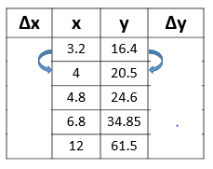
Lesson 2:
Identify a pattern within the changes in the given table.
Does this represent a linear situation? Explain why or why not.
Slide 12
Notes:
Handout goes with this PowerPoint slide. ANSWER KEY BELOW.
Possible student responses:
Students may be able to find changes and may say that the changes between the sets of the first three points. In the Rafael activity students should be able to see that there is a constant multiplier between the changes, and that the relationship is ∆y = 5.125(∆x).
Teacher notes: Students should be connecting the
ideas developed in the Rafael context and constant rate of change to the relationship between changes. Even though the numbers aren’t consistent, the multiplicative relationship is the same. It is important to start talking about linearity and asking whether the quantities in the table represent a linear situation. It is imperative for students to begin using ∆y = m(∆x). This will help students build point slope form. Refer to the front matter regarding the integration of equation and function. When we begin to use ∆y = m(∆x), the students will refer to this as a function because we have covarying quantities (∆y and (∆x)).
Misconceptions: When students see different changes in x or changes in y in the table, they may instantly say that there is no relationship or that the situation would not be linear. If this occurs, it is necessary to refer back to the Rafael situation and recall that even though he traveled 54 feet in 6 seconds, he still traveled at a constant rate of 9 ft in 1 second.

Slide 13
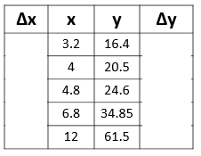
Lesson 2:
Write a contextual situation that the data could represent. Explain your reasoning and refer to the relationship between the changes.
Slide 13
Notes:
Handout goes with this PowerPoint slide. ANSWER KEY BELOW.
Possible student responses: The data in the table is from a context with a water tank being filled up at a constant rate of 5.125 gallons per minute. No matter what context students come up with, it is imperative for students to relate the rate of change to the context they come up with. (Answers will vary.)
Teacher Notes: Encourage students to present their ideas and critique the situations. The goal is to continue building context that relates to linear situations.

Slide 14
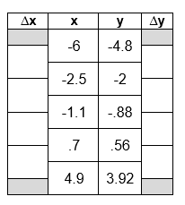
Lesson 2: Ticket Out the Door
Find the function that represents the following table using ∆y = m(∆x) after calculating the changes in x and changes in y.
Slide 14
Notes:
Handout goes with this PowerPoint slide. ANSWER KEY BELOW.
Possible student responses: : “∆y = 0.8(∆x)”

Slide 15
Lesson 3:
What is the relationship between the changes?
Given that the x and y axes have the same scale, what is the approximate rate of change for the linear functions whose graphs are given? How did you determine your answer?
Δx
Δy
Δx
Δy
Slide 15
Notes:
Possible student responses: In the first situation, students need to make a conjecture about the constant rate between Δx and Δy. Possible student response could be: ”Δx is 2 times Δy” or “Δy is $\frac{1}{2}$ of Δx.” In the second situation, possible student responses could be: “Δy is -2 times Δx” or “Δx is -$\frac{1}{2}$ times Δy. “
Teacher notes: Students need to have a solid relationship defined as Δy = m(Δx) when m is a constant, and m =$\frac{Δy}{Δx}$. It is important to note the difference between a positive rate of change and a negative rate of change. This concept will be the structure used for students to represent linear situations as a function.
Independent Practice: Relationship Between Changes word document (could be used as homework or as an assessment)
Additional resources maybe needed if students struggle with the function, Δy = m(Δx).

Slide 16
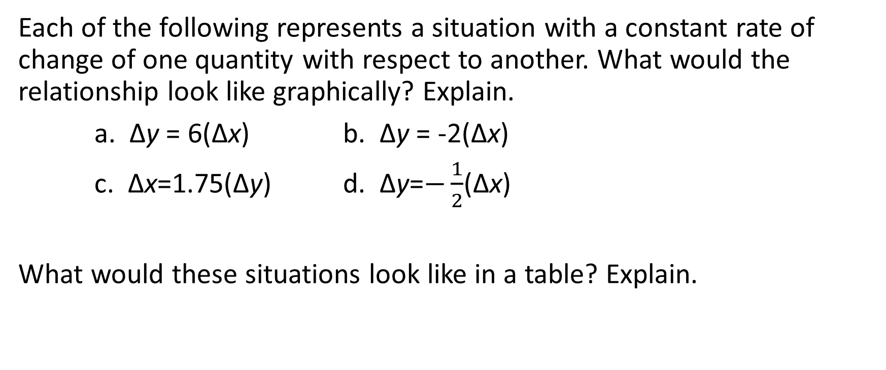
Lesson 3:
Constant Rate of Change as a Constant Multiple
Each of the following represents a situation with a constant rate of change of one quantity with respect to another. What would the relationship look like graphically? Explain.
a. Δy = 6(Δx) b. Δy = -2(Δx)
c. Δx=1.75(Δy) d. Δy=$−\frac{1}{2}$(Δx)
What would these situations look like in a table? Explain.
Slide 16
Notes:
Possible student responses: Students should be flexible with looking at the relationship from ∆y to ∆x and then ∆x to ∆y. (Answers may vary.)
Teacher notes: The teacher needs to build a conceptual understanding of the relationship between changes. This will allow students to reason with changes and make predictions about the outcomes. The teacher needs to emphasize the difference between positive and negative relationship. The teacher may want to highlight steepness and ask students: “Which of these situations increases at a faster rate? or slower rate?” Be sure students explain their reasoning. When students create tables that represent the above situations, it is essential that students use the vocabulary term function to describe the relationship between ∆x and ∆y .

Slide 17
Lesson 3:
Find the function that represents the relationship between the changes. Δy = m(Δx)
x | y
-8 | -22
-1.25 | -1.75
2.3 | 8.9
8.4 | 27.2
Slide 17
Notes:
Possible student responses: ∆y = 3•∆x; Students may say ∆y is 3 times larger than ∆x or ∆x is $\frac{1}{3}$ times ∆y.
Teacher Notes: It is important to have students make the connection that even though the changes themselves aren’t equivalent, there is a constant rate of change between x and y (i.e. that Δy always equals a constant multiplier times Δx).
Misconceptions: The order in which students subtract is important. If students are making mistakes on calculating changes, a number line will help them to identify if they are increasing or decreasing to the next value. The visual aide of a number line will help students to identify the patterns between changes.

Slide 18
Lesson 3:
Find the function that represents the relationship between the changes. Δy = m(Δx)
x | y
-0.2 | 1.4
3.4 | -5.8
8 | -15
11.9 | -22.8
Slide 18
Notes:
Possible student responses: “∆y = -2•∆x”, “∆y is -2 times ∆x”, or “∆x is $−\frac{1}{2}$ times ∆y”
Teacher Notes: It is important to have students make the connection that even though the changes themselves aren’t equivalent, there is a constant rate of change between x and y (i.e. that Δy always equals a constant multiplier times Δx).
Misconceptions: The order in which students subtract is important. If students are making mistakes on calculating changes, a number line will help them to identify if they are increasing or decreasing to the next value. The visual aide of a number line will help students to identify the patterns between changes.

Slide 19
Lesson 3:
Find the function that represents the relationship between the changes. Δy = m(Δx)
(-3, 4) and (8, -7)
(-5, 3) and (-4, 12)
(4, -2) and (-1, -3)
Slide 19
Notes:
Possible student responses:
“∆y = -11 and ∆x = 11 therefore, ∆y = -1• ∆x”
“∆y = 9 and ∆x = 1 therefore, ∆y = 9• ∆x”
“∆y = -1 and ∆x = -5 therefore, ∆y = $\frac{1}{5}$• ∆x”
Teacher Notes: If students are struggling to find changes between two points, prompt them to represent the points in other ways, eg. table or graph. Students may also find the opposite quantities for changes for example in #1 above students may find ∆y = 11 and the ∆x = -11. The teacher needs to highlight: the constant rate of change remains constant regardless of which ordered pair students begin with. The teacher may refer back to the candle problem to remind students on how they found the relationship between two given points.
Misconceptions: Throughout the lesson, we are building a conceptual relationship between quantities. Students may remember formulas from prior experiences or from home such as $\frac{y2 −y1}{x2 −x1}.$When students are referring back to formulas, the teacher should ask students to connect conceptual understanding to procedural understanding to show the process is the same.

Slide 20
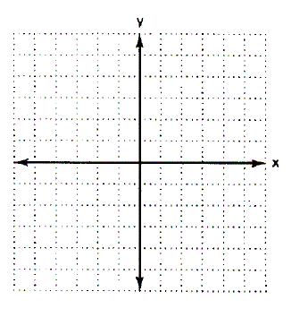
Lesson 3:
Find the function that represents the relationship between the changes. Δy = m(Δx)
Slide 20
Notes:
Handout goes with this PowerPoint slide. ANSWER KEY BELOW.
Possible student responses:
∆y = -5 and ∆x = 2 therefore, ∆y = $−\frac{5}{2}$• ∆x
Independent Practice: The teacher can print the slide and have students draw a horizontal line (in one color) to represent the change in x and a vertical line (in another color) to represent the change in y. If students ask if it depends which point they begin with, allow them to explore this idea. Students should discover the constant rate of change is the same regardless of which point they change away from.

Slide 21
Lesson 3:
Find the function that represents the relationship between the changes. Δy = m(Δx)
Slide 21
Notes:
Handout goes with this PowerPoint slide. ANSWER KEY BELOW.
Possible student responses: “∆y = 2 and ∆x = 6 therefore, ∆y = $\frac{1}{3}$• ∆x”
Independent Practice: The teacher can print the slide and have students draw a horizontal line (in one color) to represent the change in x and a vertical line (in another color) to represent the change in y. If students ask if it depends which point they begin with, allow them to explore this idea. Students should discover the constant rate of change is the same regardless of which point they change away from.

Slide 22
Lesson 4:
Jared is driving at a constant rate of 58 miles per hour.
1. What conclusions can you make with the given information?
2. Identify variables we want to use to represent distance and time.
3. Use Δ notation to represent a 2-hour time period during Jared’s drive.
4. What distance does Jared travel during his 2-hour time period? Represent your answer using Δ notation.
5. Repeat questions 3 and 4 using the following times:
  2.4 – hour time period
  0.4 – hour time period
  Any x-hour time period
6. For any change in t, how do we find the change in d? Explain, and then represent your thinking using Δ notation.
Slide 22
Notes:
Possible student responses:
In one hour Jared travels 58 miles, in half an hour Jared travels 29 miles, in two hours he travels 116 miles.
Possible responses may include ∆d and d for distance, ∆t and t for time.
∆t = 2
∆d = 58(2) therefore ∆d = 116
A. ∆t = 2.4; ∆d = 58(2.4), therefore ∆d = 139.2
B. ∆t = 0.4; ∆d = 58(0.4), therefore ∆d = 23.2
C. ∆t = x; ∆d = 58(x), therefore ∆d = 58x
∆d = 58(∆t)
Teacher notes: Now that students can make sense of the constant rate of change, context will help students reason through applying the changes given the rate of change. Require students to use the structure of change notation representing the situations using both expressions and equations.

Slide 23
Lesson 4:
The cost of gummy bears increases at a rate of $7.99 per pound, so we can calculate the change in total cost if we change the amount of candy we purchase. Let c represent the total cost of purchasing gummy bears in dollars. Let w represent the weight of candy purchased in pounds.
In a bag of gummy bears we add 2 more pounds of gummy bears. Represent the change in the number of pounds of gummy bears using Δ notation.
How much does the total cost of the gummy bears we purchase change? Represent your answer using Δ notation.
Repeat parts (a) and (b) with the following pounds of candy:
  Add 1.7 pounds of gummy bears to the bag.
  Add 0.45 pounds of gummy bears to the bag.
  Remove 1.2 pounds of gummy bears from the bag.
For any change in w, what happens to the change in c? Explain, then represent your thinking using Δ notation.
If your friend gives you $13 to purchase more gummy bears, how many additional pounds of gummy bears would you add to your bag?
Slide 23
Notes:
Possible student responses:
a. ∆w= 2
b. ∆c = 7.99(2) therefore ∆c = 15.98
c. A. ∆w = 1.7; ∆c = 7.99 (1.7), therefore ∆c = 13.58
B. ∆w = 0.45; ∆c = 7.99(0.45), therefore ∆c = 3.60
C. ∆w = -1.2; ∆c = 7.99(-1.2), therefore ∆c = -9.59
∆c = 7.99∆w
13 = 7.99(∆w) therefore you can add 1.627 lbs of gummy bears to your bag
Teacher notes: Now that students can make sense of the constant rate of change, context will help students reason through applying the changes given the rate of change. Students should recognize that when gummy bears are removed the cost will be decreasing.

Slide 24
Lesson 4:
Connecting relationship between changes to finding values of x or y.
We know that the changes in the values of two variables are related according to Δy = 3· Δx
If we start off at x = 5 and let x change to be x =12.
  1. What is the change in x?
      2. By how much does y change for the change in x you found.
      3. We know that y = -2 when x = 5. What is the value of y when x =12? How do we find this?
      If we start off at x = 7 and let x change to be x =-3.
  1. What is the change in x?
      2. By how much does y change for the change in x you found.
      3. We know that y = 8 when x = 7 What is the value of y when x =7?
      How do we find this?
      Which type of questions elicit an expression, equation, or function? Explain your thinking.
Slide 24
Notes:
Possible student responses: If we start off at x = 5 and let x change to be x =12.
∆x = 12 – 5 therefore, the ∆x = 7
∆y = therefore, the ∆y = 3(7) , which means ∆y = 21
(y – (-2)) = 3(12 – 5)
y + 2 = 3(12 – 5)
y + 2 = 21
y = 19
If we start off at x = 7 and let x change to be x =-3.
∆x = -3 – 7 therefore, the ∆x = -10
∆y = therefore, the ∆y = 3(-10) , which means ∆y = -30
(y – 8) = 3(-3 – 7 )
y – 8 = 3(-10)
y – 8 = -30
y = -22
Teacher Notes: Students may struggle without the graph, encourage students to justify their responses graphically. Also, the structure of the expressions is imperative. If students are able to come up with responses, continue to have students write each piece as an expression or equation. Students need to be able to represent ∆x and ∆y as expressions like in question 1. In questions 2 and 3, students are using the vocabulary equation because they are solving for an unknown quantity. Refer to the front matter for more specifics between the application of vocabulary between equation and expression.

Slide 25
Lesson 4:
We know that two variables (x and y) are related such that Δy = -3(Δx).
1. What does this statement Δy = -3(Δx) mean?
2. If x changes from x = 1 to x = 9, by how much does y change?
3. How much does y change by if x changes from x = 4 to x = -2?
4. If y changes to y = 8 from y = 10, by how much does x change?
Slide 25
Notes:
Possible student responses:
The change in value of y is consistently -3 times the change in the value of x.
∆x = 9 – 1 = 8, therefore ∆y = -3(8) = -24
∆x = -2 – 4 =-6, therefore ∆y = -3(-6) = 18
∆y = 8 – 10 =-2, therefore ∆x=- $\frac{1}{3}$ (-2) = $\frac{2}{3}$
Teacher Notes: The goal is for teachers to make sure students can apply the changes given one change in a quantity and the rate of change (also known as slope.) The teacher now may need to discuss that rate of change and slope are synonyms. On question 4, students need to be able to reason using the relationship between changes even though the given information is change in y versus change in x. Students may need additional prompting to understand they are using the same function.
Misconceptions: Struggling students may have a hard time identifying the change just by the phrases. One way to help them see whether the change is increasing or decreasing is using a number line. The language to and from is important for them to consider when identifying changes.

Slide 26
Lesson 5:
Now using the changes, find ordered pairs that will be represented in the same linear scenario
Slide 26

Slide 27
Lesson 5:
What is the relationship between the changes?
Given that the x and y axes have the same scale, applying the approximate rate of change, ∆y = 0.75•∆x for the linear functions whose graphs are given, what is (x₁, y₁)? How did you determine your answer?
(x₁, y₁)
(2, 2.5)
Δy =
Δx= 4
Slide 27
Notes:
Student responses: “∆y = 3 given ∆x = 4 because ∆y = $0.75$• 4”
Using this information, now students will find the ordered pair using the original point and the changes. (2 + 4, 2.5 + 3) would give a new point of (6, 5.5)
Teacher Notes: Some students may need to represent the information in a table to help. If students are struggling, remind them of the difference between a quantity and a change in quantity. As an extension, invite students to find additional ordered pairs that would fall on the line. Again, it is important to highlight that when using ∆y = 0.75(∆x) refer to a function. Once the value of ∆x is identified and students are solving for ∆y they now are going to use the term equation.
Misconceptions: It is important for students to decipher between changes in quantities and quantities. Refer to the candle problem or any context where they can see the relationship between changes. Students may misuse the vocabulary function and equation.

Slide 28
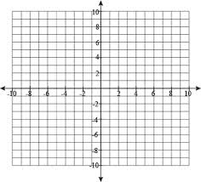
Lesson 5:
Given that Δy = -3(Δx), find the ordered pair when x changes to x = -1 from the ordered pair on the graph.
Slide 28
Notes:
Student Responses:
∆x = -1 – (-4)
∆y = -3(-1 + 4)
∆y = -3(3) = -9
(y – (-2)) = -3(-1 + 4)
y + 2 = -9
y = -11
Ordered pair is (-1, -11)
Teacher Notes: Remind students that the expectations are to make sense of the expressions along the way. This structure will enhance their understanding of point slope form to in turn apply to slope-intercept form that they have used previously in pre-algebra. Prompt student questions regarding the negative relationship and ask them to verify their answer based on the constant rate of change. Note the function is given ∆y = -3(∆x), the students will be solving an equation.

Slide 29
Lesson 5: Given that Δy = (Δx), find the ordered pair when x changes to x = -5 from the ordered pair on the graph.
Slide 29
Notes:
Student Responses:
∆x = -5 – 1
∆y = $\frac{1}{2}$ (-5 – 1)
∆y = $\frac{1}{2}$ (-5 – 1) = -3
(y – 3)= $\frac{1}{2}$ (-5 – 1)
y – 3 = -3
y = 0
Ordered pair is (-5, 0)
Teacher Notes: Remind students that the expectations are to make sense of the expressions along the way. This structure will enhance student understanding of point slope form to in turn apply to slope-intercept form that was used previously in Pre-Algebra. Prompt student questions regarding the positive relationship between the changes and ask students to verify their answer based on the constant rate of change.

Slide 30
Lesson 5: Using the relationship between changes,
Δy = -3(Δx), fill in the values of y.
x | y
-8
-1.25 | -1.75
2.3
8.4
Slide 30
Notes:
Student responses:
Teacher Notes: Continue to discuss expression, equations, and function. When students are finding changes, they are using expressions. The function is given ∆y = -3(∆x). Once students develop the expression and then apply the expression within the function, they are now solving an equation.

Slide 31
Lesson 5: Using the relationship between changes,
Δy = 4(Δx), fill in the values of y.
x | y
-8
-1 | -8
2
8.4
Slide 31
Notes:
Student Responses:

Slide 32
Lesson 5: Using the relationship between changes,
Δy = -1.8(Δx), fill in the values of y.
x | y
-6
-1
5 | -3
8
Slide 32
Notes:
Student Responses:

Slide 33
Lesson 5:
What defines a function?
How does a function differ from an expression and an equation?
Slide 33
Notes:
Student responses: Within the teacher notes the application of the three terms are used throughout. Student answers may vary. The expectation, at this point, is for students to use the word expression when they are looking at the changes in quantities. Specifically, students need to see expressions as a process of computing and a result of the computation. It is important that students see expressions as multiple equivalent representations. When students are referring to an equation, they will be solving for one quantity. For functions, there are two covarying quantities, such as ∆y = m∆x, (y – y₁) = m(x – x₁), and y = mx + b.
Students need to be able to see that given a function, they can identify expressions that are represented in the function, such as ∆x, m(∆x), and ∆y. Once one quantity is given within a function, students are now solving an equation.

Slide 34
Lesson 5:
Connecting Δy = m(Δx) to writing a function that works for any given point.
Slide 34

Slide 35
Lesson 5: Write a function that works for any given point.
What do you know about the linear function?
Write a function that goes from one of the points to any point (x, y).
Slide 35
Notes:
Student Responses:
Students should say the rate of change is 3 and that the line goes through the points (-5, -1) and (-4, 2).
2. ∆y = 3(∆x) ∆y = $3($∆x)
Changing away from the ordered pair (-5, -1) Changing away from (-4, 2)
(y + 1) = 3(x + 5) (y – 2) = $3$(x + 4)
Teacher Notes: At this point in the unit students need to write a linear function that would work for any given point on the line. When asking students to pick a point to change away from, they need to see that it doesn’t matter which given point is used. They will arrive at the same linear function either way. The purpose of deriving point-slope form is because it works in any given situation. A suggestion that might help with this is to have students in partners and each partner chooses a different given point to change away from. For example, partner A writes a function changing away from (-5, -1) and partner B writes a function changing away from (-4, 2). When they write their functions, ask students to compare the functions. Some students will naturally simplify the function and write the function in slope-intercept form. The next slide will guide them to simplify all the way to slope-intercept form. This is not always necessary but it is commonly used with linear functions. It should be something students have already been exposed to in Pre-Algebra.

Slide 36
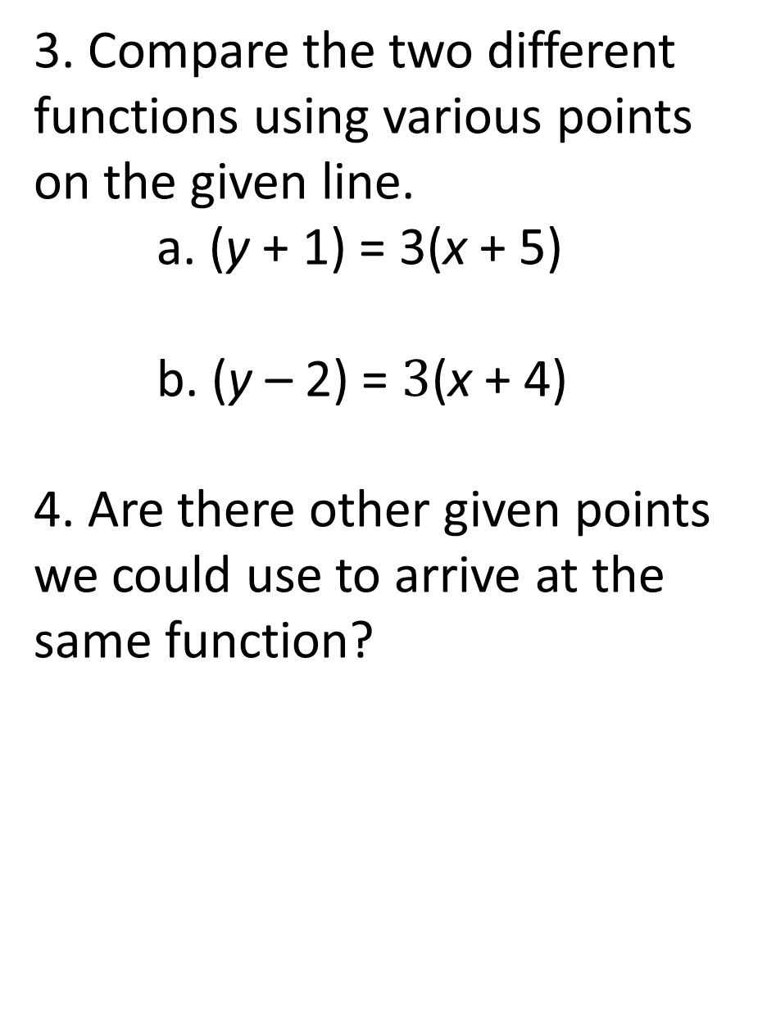
Lesson 5:
Write a function that works for any given point.
3. Compare the two different functions using various points on the given line.
a. (y + 1) = 3(x + 5)
b. (y – 2) = $3$(x + 4)
4. Are there other given points we could use to arrive at the same function?
Slide 36
Notes:
Student Responses:
3. Students will find that either function will give them y = 3x + 14 once simplified. Answers may vary. To prove either function would give the same information, students should substitute a value in for x or y and the solve the equation for the missing variable. Students should discover both equations will arrive at the same point. Students could also state they have the same y-intercept.
4. Yes, another given point could be (-3, 5) or a point at any part of the line. When starting from a graph, choosing points that are integers makes it easier to manipulate.
Teacher Notes: If students in number 3 respond to only one part of the student response, ask students probing questions that could get them to the specific answer. For example, if they don’t arrive at y = 3x + 14, then ask students if they could simplify the function further. At this point the teacher could also ask: “what 14 in the function represents?”, “Why is the y-intercept is a special point that is useful with linear functions?” At this point, it is important to note that when we simplify to y = 3x + 14 it is referred as slope-intercept form. This form entails the rate of change and the y-intercept. Slope-intercept form should be something students are familiar with in previous math classes. If students don’t verify by plugging in specific values, ask them to prove that both function would give them the same y value if x is a specific value, for instance what is y if x is -2 or 0. The purpose of question four is to consistently remind the students that even though two point are highlighted on the graph by circles, there are infinite solutions (points) on any given line.
Misconceptions: Students tend to think the only points on a line are those indicated with a circle.

Slide 37
Lesson 5:
Write a function that works for any given point. Simplify to slope-intercept form. Document your thinking on the handout.
Slide 37
Notes:
Handout goes with this PowerPoint slide. ANSWER KEY BELOW.
Student Responses:
Graph 1: Graph 2:
∆y = -2(∆x) ∆y = $−\frac{1}{4}$(∆x)
Changing away from the ordered pair (2, 3) Changing away from (-3, 2)
(y – 3) = -2(x – 2) (y – 2) = $−\frac{1}{4}$ (x – (-3))
y – 3 = -2x + 4 y – 2 = $−\frac{1}{4}$x $−\frac{3}{4}$
y = -2x + 7 y = $−\frac{1}{4}$x + 1$\frac{1}{4}$
Teacher Notes: Students may struggle coming up with the expressions that represent the change in y and the change in x. One way to help students is to prompt them to represent the information in a table and ask how to identify changes between two quantities. With the progression of the unit, students may not be solving for y yet but it would be a great point to ask questions about the similarities and differences of point slope form and slope intercept form. At this point, ask questions about when to use point slope form and slope intercept form. Possible responses may be: “When using slope intercept form, we are looking at changing away from the y – intercept .” In point slope form, we are changing away from any given point.” Keep in mind the structure of the expressions that students write. It will help students to be successful and continue to reason mathematically. Encourage students to always verify their function is correct by using another point.

Slide 38
Lesson 5: Write a function from the given information. Simplify to slope-intercept form. Document your thinking on the handout.
x | y
-3 | 2.4
-1 | 2.8
0.5 | 3.1
2 | 3.4
x | y
-5 | 16.25
-1 | 10.25
1.5 | 6.5
2 | 5.75
Slide 38
Notes:
Handout goes with this PowerPoint slide. ANSWER KEY BELOW.
Student responses:
Students may vary. The ordered pair they choose to move from may be different ; however, students should identify they will get the same function in the end.
Table 1: Table 2:
∆y = 0.2(∆x) ∆y = $−1.5$(∆x)
Changing away from the ordered pair (2, 3.4) Changing away from (1.5, 6.5)
(y – 3.4) = 0.2(x – 2) (y – 6.5) = $−1.5$ (x – 1.5)
y – 3.4 = 0.2x – 0.4 y – 6.5 = $−1.5$x + 2.25
y = 0.2x + 3 or y =$\frac{1}{5}$ x + 3 y = – 1.5x + 8.75
Teacher Notes: For these questions four different points are given. Facilitate students to share their solution paths by using different points and continue to compare. The students should develop, no matter which point you begin with, the slope-intercept form will always be the same if all math is done correctly.
Additional Practice: Provide for students to practice finding the function. If students are not developing the idea that by using different starting points, it still results in the same function; take time to have students analyze and critique the work of peers.

Slide 39
Lesson 5: Application of linear functions.
Student Council is purchasing stickers as a fundraiser. Company A only sells stickers in sets of 100. The first 100 stickers are $18.00, which also includes a one time flat fee for shipping. For every set after the initial 100 stickers, it costs $12. Write the function for the scenario.
Slide 39
Notes:
Handout goes with this PowerPoint slide. ANSWER KEY BELOW.
Student responses: For the context of this problem. it wouldn’t make sense to use point-slope form because the y-intercept is easily found. Students should subtract $12 from $18 to find the one time fee to purchase stickers. The one time shipping fee is $6.00, which also represents the y-intercept. In the context. it gives a cost for a set of 100, depending on how students define x their functions can be one of two possibilities. If students define x as the number of sets of 100, the function would be y = 12x + 6. If students define x as the price per sticker, (making note that the quantity has to be purchased in sets of 100) they could divide $12 by 100 to find the price per sticker as $0.12. In this case the function would be written as y = 0.12x + 6.
Teacher notes: If students don’t write the function in slope-intercept form at first, they should still arrive at the same function. However based on the information given, we want to encourage our students to use the given information to decide whether to use slope-intercept form right away or use point-slope form and then simplify. Again, for this particular context slope-intercept form would be the quickest form to use. If students have a hard time finding the slope, encourage students to define what x represents. Also, if students only come up with one of the functions, ask students to try to find a different function by defining x differently. Another suggestion to get students to come up with the second equation is to ask students to write a function representing the cost per sticker instead of the price per set of 100 stickers. The purpose is to get students exposed to begin writing functions in slope-intercept form when appropriate.

Slide 40
Lesson 5:
Given the context, write the linear function.
Your family is renting a beach house this summer. The company charges a processing fee and a daily fee. Your cousin rented the beach house for 4 days and paid $450. Your friend rented the same beach house for 6 days and paid $654. Find the function that represents the scenario.
What is the daily fee? Processing fee? Explain.
Slide 40
Notes:
Handout goes with this PowerPoint slide. ANSWER KEY BELOW.
Student responses: In this context the y-intercept isn’t given, students should choose to start this problem in point-slope form. Students should find that the rate of change is $102, which represents the daily fee. After students find the function, they should say the daily fee is $102 and the processing fee is $42, this also would be the y-intercept.
Option 1: Option 2:
∆y = 102(∆x) ∆y = $102$(∆x)
Changing away from the ordered pair (4, 450) Changing away from (6, 654)
(y – 450) = 102(x – 4) (y – 654) = $102$(x – 6)
y – 450 = 102x – 408 y – 654 = $102$x – 612
y = 102x + 42 y = 102x + 42
Teacher notes: If students have difficulty starting, encourage them to define their variables. Students should determine y represents the total cost and x represents the daily fee. Students should also be able to identify the rate of change is representing the number of days staying at the beach house and the y-intercept represents the processing fee. The teacher needs to be helping students to identify that with the given information, slope-intercept form would be the best representation. Typically students may want to start with point slope form. Students need to have flexibility in their understanding of the two forms.

Slide 41
Lesson 5:
Ticket Out The Door: What would you do?
Your teacher presents any two given points which are not on the y-axis.
Write a linear function that would be appropriate for this situation. What information do you need to identify? Which form would you choose and why? Provide an example to prove your reasoning.
Slide 41
Notes:
Handout goes with this PowerPoint slide. ANSWER KEY BELOW.
Student Responses: Students should begin by finding the rate of change using the two given points. Next, students would pick one point and use the point-slope form to write their function. Students may proclaim because the y-intercept isn’t given so they would not use slope-intercept form to begin with however, it would be possible to find the function this way.
Teacher Responses: Encourage students to use examples proving how they would write the function. For an extension, have students provide an actual scenario representing point slope form and another scenario that would promote starting with slope-intercept form.

Slide 42
Lesson 6 - Modeling the Candle Problem
2016 Megan Jeffers, Melissa Stanley, & Sarah Winzeler
Slide 42
Notes:
Prior to this lesson students should watch the Candle Burning Video Act 2.

Slide 43
Lesson 6: Candle Burning Act 2
Watch the following video
https://www.youtube.com/watch?v=2ERerVFbNuE
Slide 43
Notes:
Google: Candle Burning Act 2 Video is uploaded by Kyle Pearce

Slide 44
Lesson 6:
What do you notice?
Did you observe anything unexpected?
Do you have any new questions?
What does this information look like in a table?
Slide 44
Notes:
Possible Student Responses: Answers will vary depending on which two points they select to begin finding the rate of change. Students may or may not notice at this point that the rate of the change of the burning candle is not constant across all points. Some may argue that it’s not perfectly linear for this reason, though a linear model best fits the situation.
Teacher Notes: Students may need to see the Candle Burning Video Act 2 a second time in order to create a table of values. Many of the previous examples the students have examined are perfectly linear, so a class discussion of real-world data would be appropriate. Perhaps ask the students to consider reasons the candle burning might not have been perfectly linear.
Misconceptions: The various rates of change that the students find should all be negative, but a common student error is to disregard signs when finding rates of change.

Slide 45
Lesson 6:
Use your table to find the Rate of Change
Between consecutive points
Between several nonconsecutive points
What did you notice?
Slide 45
Notes:
Possible Student Responses: Students should find that the rate of the change of the burning candle is not constant across all points. However, the various rates of change that the students find should all be negative.
Teacher Notes: Remind students who are struggling of their previous work with delta notation and using expressions to compute change.
Misconceptions: Sometimes students think they can only find rates of change between consecutive points on a table, and pushing them to explore nonconsecutive points forces them away from relying on procedural habits. Also, as previously stated, a common student error is to disregard signs when finding changes away from a value. Students need to attend to precision.

Slide 46
Lesson 6:
Explain whether or not the candle problem still represents a linear function.
What rate of change best represents the data? Discuss.
What would a graph of the given information look like?
How can we use the given information to find other values such as the length of time it takes for the candle to extinguish?
Slide 46
Notes:
Possible Student Responses:
Students should find that a linear model is still a good way to represent the relationship between the height of the candle and the time the candle has been burning, even though the rates of change are not perfectly constant.
Students may have the idea of averaging the rates of change, or using the median or mode as a representative rate of change. Student answers should demonstrate that they understand the rate of change is negative. This is a good opportunity to reinforce what it means that the rate of change is negative – that the height of the candle is decreasing as the length of time the candle has been burning is increasing.
Some students may simply plot the discrete points given in the video. Others may have the idea of drawing a line that best fits the given data as well, which is the direction the third candle video will take.
Students who drew a line of best fit may use it to visually approximate unknown values. Other students may instead choose two reference points and write a linear function in point-slope form, building on previous class experiences. Some students may combine the two strategies by drawing a line of best fit, and then using two reference points on that line to write a linear function.
Teacher Notes: Encourage students to make connections with their previous work with the candle problem. It is still appropriate to write a linear function modeling covarying quantities. Reinforce that additional data points allow us to model the problem more accurately than if we were only given two points. While actually determining the exact line of best fit using is not the standard this lesson is addressing, students may benefit from opportunities to examine lines of best fit using technology.
A potential technology resource is the website www.desmos.com. After navigating to the site, click “start graphing”. Under the “add item” drop down menu, select “table”. Click “open graph” in the upper left corner of the screen, and select “Statistics: Linear Regression”. Click “open graph”, and Desmos will automatically populate a table of values and draw the corresponding line of best fit. Students are able to change values in the table to see how it affects the line of best fit. Depending on whether students have access to their own computers, they could explore individually, in small groups, or as a whole class on a projector screen.
Misconceptions: Some students might struggle with moving away from writing a linear function given limited information (such as two data points, or one data point and a rate of change) to writing a linear function given multiple data points that are not perfectly linear. See teacher notes above addressing this potential struggle.

Slide 47
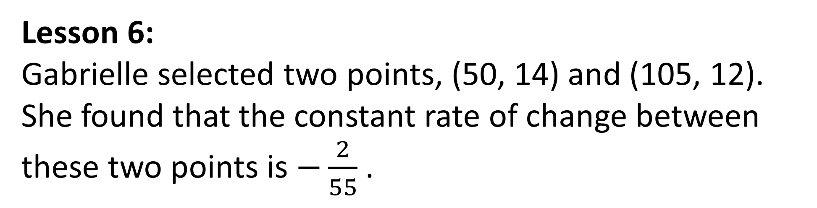
Lesson 6:
Gabrielle selected two points, (50, 14) and (105, 12). She found that the constant rate of change between these two points is $−\frac{2}{55}$ .
Pair Share:
Do you agree with Gabrielle’s rate of change? Why or why not? What is the contextual meaning?
Slide 47
Notes:
Possible Student Response: Students should agree with Gabrielle’s rate of change. The candle decreased in height by 2 cm during the 55 minute period the candle was burning.
Teacher Notes: Student answers should include units and specifically address the context, rather than just defining slope.

Slide 48
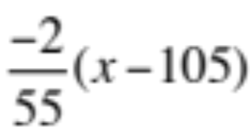
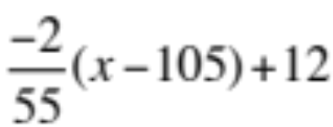
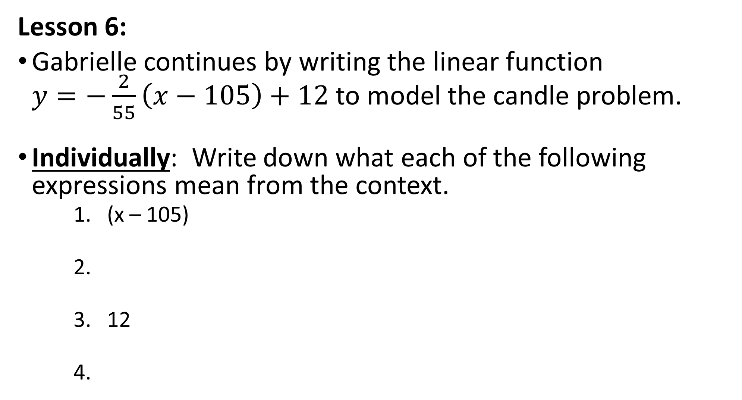
Lesson 6:
Gabrielle continues by writing the linear function $y=−\frac{2}{55}\left(x−105\right)+12$ to model the candle problem.
Individually: Write down what each of the following expressions mean from the context.
    1. (x – 105)
    2.
    3. 12
    4.
Slide 48
Notes:
Possible Student Responses: Collect student work samples. This is a good opportunity to assess students’ recollection of prior learning objectives in this unit related to HSA.SSE.A.1.a.
(x – 105) ; the change in the time the candle has been burning away from the selected reference point time of 105 minutes
2. $\frac{−2}{55}\left(x−105\right)$ ; the change in the height of the candle away from the selected reference point height of 12 cm corresponding with the change in time away from 105 minutes
3. 12 ; the reference point output value, or height of the candle when it had burned 105 minutes
4. $\frac{−2}{55}\left(x−105\right)+12$ ; the height of the candle when it has been burning x minutes, found using the selected reference point (105, 12). Students should connect that the expression is formed by adding the initial height of the candle, 12 cm, and the change in height away from 12 cm.
Teacher Notes: Use the students’ work samples to determine whether it is necessary to review prior lessons before continuing.

Slide 49
Lesson 6:
Small Group Activity:
Determine the equation of the linear function you feel BEST fits the given data. Be prepared to explain your reasoning.
Whole Group Activity:
Share your group’s linear function with the class. As a class, select a single representative function, and explain your reasoning.
Slide 49
Notes:
Possible Student Responses: Group answers should show that they understand the rate of change is negative. Students may tackle the problem in different ways. Some may identify the y-intercept, and use slope-intercept form with the representative rate of change they found earlier. Some students may use point-slope form with two of the given points. The formats of the student answers may vary, and students using point-slope form may want to simplify their answers to slope-intercept form in order to better compare the functions.
Teacher Notes: This activity supports HSS-ID.B.6a and HSS-ID.B.6c, but is not intended to address the full depth of those standards. When the class concludes their discussion, students should watch the Candle Burning Video Act 3.

Slide 50
Lesson 6: Candle Burning Act 3
Watch the following video
https://www.youtube.com/watch?v=ZaddIExIq_A
Slide 50
Notes:
Google: Candle Burning Act 3 Video is uploaded by Kyle Pearce

Slide 51
Lesson 6: Pair Activity:
What is the domain of a linear function?
After watching Act 3 of the Candle Burning Video, what do you feel is a reasonable domain in context?
Determine whether we need to restrict the domain to make sense in this context.
Slide 51
Notes:
Possible Student Responses:
The domain of a linear function is all real numbers.
A reasonable domain in context would be all real input values between 0 minutes and 362 minutes.
We must restrict the domain because the time that the candle has been burning cannot be negative, nor can the candle continue to burn when it is gone.
Teacher Notes: This would be a good opportunity to discuss situations in which we might further restrict domain to positive integers (for example, if the input was number of people etc.).
Misconceptions: Some students may argue that the domain of vertical lines is not all real numbers, however, vertical lines are not functions. This is a good opportunity for students to discuss what is a function.

Slide 52
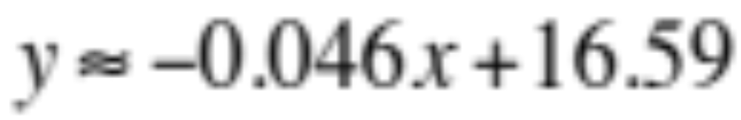
Lesson 6: The line that BEST fits the given data is
Identify and interpret the slope of the Line of Best Fit.
Identify and interpret the y-intercept of the Line of Best Fit.
What does (0, 17) mean in context?
Slide 52
Notes:
Possible Student Responses:
Slope -0.046; The candle will decrease by about 4.6 cm for each 100 minute period of time it has been burning.
Y-intercept (0, 16.59); This would represent the original height of the candle based on the linear model that best fits all data points.
(0, 17) represents the actual original height of the candle. The data is not perfectly linear, so the actual original height of the candle and the original height as predicted by the line of best fit are slightly different. It would be beneficial for students to discuss the difference between actual data point, and points on the line of best fit.
Teacher Notes: Before students answer the questions, this is a good opportunity to clarify/remind them that interpreting the slope or y-intercept is explaining what it means in context. Also, now that students are given the actual line of best fit, it may be beneficial to discuss which groups’ strategies resulted in a line close to the line of best fit. Depending on the students’ prior experiences, it may also be beneficial for them to verify the line of best fit using their calculators, though that is not the focus of this lesson.
Misconceptions: A common student error is to instead define slope or y-intercept, which is not what the question is asking.

Slide 53
Lesson 6: Small Group Discussion:
What is the purpose of using a line of best fit, rather than actual data points?
Slide 53
Notes:
Possible Student Response: The line of best fit allows us to predict missing values. This is useful because we are given a limited set of actual data points, but can predict any value using the line of best fit.
Teacher Notes: Take the opportunity to reinforce the difference between actual data points, and points on the line of best fit.
Misconceptions: Students sometimes use the actual data points to predict missing values, rather than the line of best fit. This occurs most frequently when the given value (input or output) corresponds with the value of an actual data point’s (input or output).

Slide 54
Lesson 6:
The line of best fit for the given data is
Use the line of best fit to predict the height of the candle when it has been burning 200 minutes.
Slide 54
Notes:
Possible Student Response: Students should use the line of the best fit to find the predicted height of the candle, plugging in 200 minutes as the input value. Predicted height is about 7.39 cm. Some students may round.
Teacher Notes: Continually require students to attend to precision by including units.

Slide 55
Lesson 6: Ticket Out the Door:
Why do we draw a line of best fit?
What is the relationship between actual data points and points of the line of best fit?
Slide 55
Notes:
Handout goes with this PowerPoint slide. ANSWER KEY BELOW.
Possible Students Responses: We draw a line of best fit to model data showing a linear relationship between two varying quantities and to make predictions. The actual data points represent observations, and may not be on the line of best fit. The line models the relationship between the two covarying quantities; points of the line are predictions and may differ from observed data points.
Teacher Notes: Collect students’ tickets out the door. Use student work to determine whether a follow-up class discussion is necessary.

Slide 56
Lesson 7 - Interpreting Linear Models
2016 Megan Jeffers, Melissa Stanley, & Sarah Winzeler
Slide 56
Notes:
Teacher Notes:
Students will still be examining linear functions and making sense of problems contextually. However, this lesson focuses on pulling in HSS-ID.C.7, a statistics standard related to linear models. While it is not included in this unit, addressing HSS-ID.C.8 following this lesson would be appropriate. Also, take every opportunity throughout the lesson to pull in students’ prior experiences in this unit, including vocabulary (expression, equation, function), delta notation, and the relationship between slope-intercept and point-slope forms of a linear function.

Slide 57
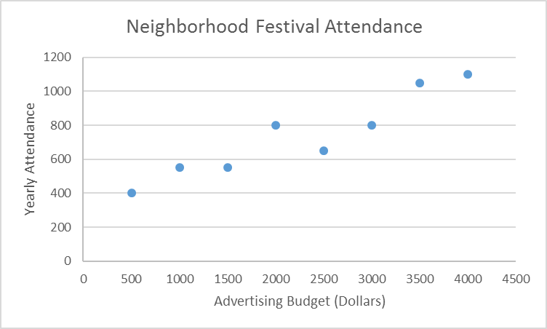
Lesson 7: What information does the graph provide?
Slide 57
Notes:
Possible Student Responses: Students should explain the context, that as the advertising budget for a neighborhood festival increases, the number of people who attend that festival will also increase.
Teacher Notes: Consider pulling up images of festivals online if students unfamiliar with the term, particularly ELL students. Also, if students don’t use the term correlation in their responses, this is a good opportunity to discuss that the graph shows a positive correlation between money spent on advertising a neighborhood festival and the number of people who attend the festival each year.
Students have been referring back to the candle problem repeatedly in this unit, and have previously created a graph of discrete data points. If class time permits, encourage students to compare/contrast the two scenarios. The candle problem tracks one candle as it burns all the way down. An input value cannot repeat with a different output value in the candle problem. However, in the context above this could occur. The advertising budget could be the same in different years, with differing corresponding yearly attendance.

Slide 58
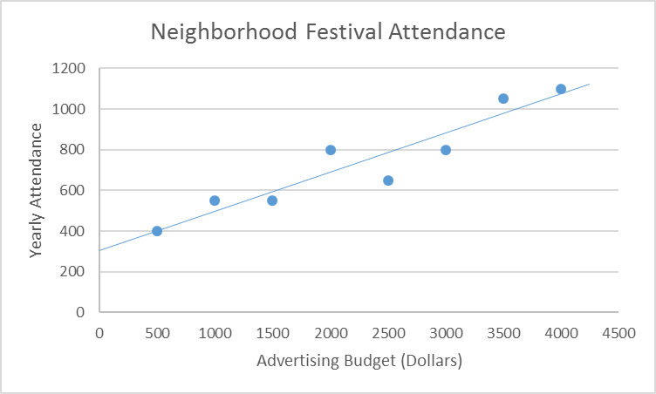
Lesson 7: What is a reasonable equation of the line of best fit graphed below?
Slide 58
Notes:
Possible Student Responses: The equation of the regression line is $y≈0.19048x+308.93$. Students are limited by the graph, and might reasonably say $y≈0.2x+300.$ Students using point-slope form may need to simplify to slope-intercept form in order to compare functions with other students.
Teacher Notes: Students may use different methods to find the function above. If students are struggling, refer to previous work in the unit with reference points on a line, computing changes away from a reference point using expressions, and the relationship between change in y and change in x. At this point in the unit, students should be able to comfortably generate linear functions from tables/graphs. If this is not the case, work on this example as a whole class and provide the students with additional examples to work on in pairs, and then individually. You may also need to reinforce the relationship between point-slope and slope-intercept forms previously discussed.

Slide 59
Lesson 7:
Identify and interpret the y-intercept of the line of best fit.
Slide 59
Notes:
Possible Student Response: Based on the limitations of the graph, students should identify an approximate value, such as 300 or just over 300. This means that if no money is spent on advertising, about 309 people would still attend the neighborhood festival.
Teacher Notes: While the actual y-intercept is (0, 308.93), students will need to approximate.
Misconceptions: Students are frequently confused when asked to interpret the parameters of a linear model in context. Prior experiences in this unit should help them; refer back to the candle problem as an example if necessary.

Slide 60
Lesson 7:
Identify and interpret the slope of the line of best fit.
Slide 60
Notes:
Possible Student Response: Based on limitations of the graph, students should identify an approximate slope using points on the line, such as approximately 1/5. This means that attendance at the festival increases by about 1 person for every additional $5 spent on advertising.
Teacher Notes: While the actual slope is 0.19048, students will need to approximate. Be sure to use the term constant rate of change interchangeably with slope (and point it out to students) to reinforce vocabulary, particularly for ELL students.
Misconceptions: Students are frequently confused when asked to interpret the parameters of a linear model in context. Prior experiences in this unit should help them; refer back to the candle problem as an example if necessary.

Slide 61
Lesson 7:
What does (3500, 1050) represent on the graph?
Slide 61
Notes:
Possible Student Response: (3500, 1050) is an actual observed data point, and is not on the line of best fit. It represents one year in which $3500 was spent on advertising and 1050 people attended the festival.
Teacher Notes: Require that students use units. This question and the next to meant to draw students’ attention to points on the line of the best fit vs. actual data points.

Slide 62
Lesson 7:
What does the point (3500, 975.6) on the line represent?
Slide 62
Notes:
Possible Student Response: The point (3500, 975.6) on the line represents that if $3500 is spent on advertising, we would predict that 976 people would attend the festival.
Teacher Notes: This is great opportunity to discuss that the practical domain is restricted to whole numbers, though the equation of the actual line of best fit is not.
Misconceptions: A common student misconception is to make predictions based on actual data points, rather than using the line of best fit.

Slide 63
Lesson 7:
Predict the attendance at the festival if $2750 is spent on advertising.
Slide 63
Notes:
Possible Student Response: Students should use the line of best fit to predict that approximately 833 will attend the festival when $2750 is spent on advertising. Students are limited by the graph, and might reasonably predict attendance of 825 or just over 800.
Misconception: Consider asking the follow up question “what would be the predicted attendance if $1000 was spent on advertising?” to target the student misconception of using data points to predict, instead of the line of best fit. A student using the data point would predict an attendance of approximately 550, instead of the prediction obtained using the line of best fit of approximately 500 .

Slide 64
Lesson 7: SMALL GROUP DISCUSSION:
Contrast finding the domain of a linear equation given without context, and finding a practical domain of a line of best fit representing a contextual situation.
Slide 64
Notes:
Possible Student Responses: Sometimes in context certain values do not make sense. For example, in this situation it doesn’t make sense to have a negative advertising budget or to spend millions of dollars advertising a neighborhood festival, even though the domain of the line y = 0.2x + 300 is all real numbers.
Teacher Notes: After allowing students to discuss in small groups, they should share their reasoning with the class. This is an additional opportunity to discuss contextual examples where students may need to restrict domain values to whole numbers (for example, if the input value represented number of people).

Slide 65
Lesson 7: What would be a reasonable practical domain in this context?
Slide 65
Notes:
Possible Student Responses: Students should discuss reasonable domain restrictions based on the context, and potential pitfalls of extrapolating far outside the domain of the data points given. For example, students may limit the practical domain to nonnegative values less than or equal to $5000. Answers may vary, but should be reasonable. Students should discuss that a negative advertising budget doesn’t make sense.
Teacher Notes: In order to attend to precise mathematical language, this is a great opportunity to discuss the vocabulary terms interpolation and extrapolation with students if they have not already been defined in class. Interpolation is predicting output values that correspond with input values within the domain of the given data, i.e. using the part of the line of best fit between your existing data points. Extrapolation is predicting output values corresponding with input values outside the domain of your data set. You may want to give examples from the graph to help visual learners and ELL students. For example, predicting the yearly attendance for an advertising budget of $2750 is interpolating, and predicting the yearly attendance for an advertising budget of $5500 would be extrapolating.

